Slide 4
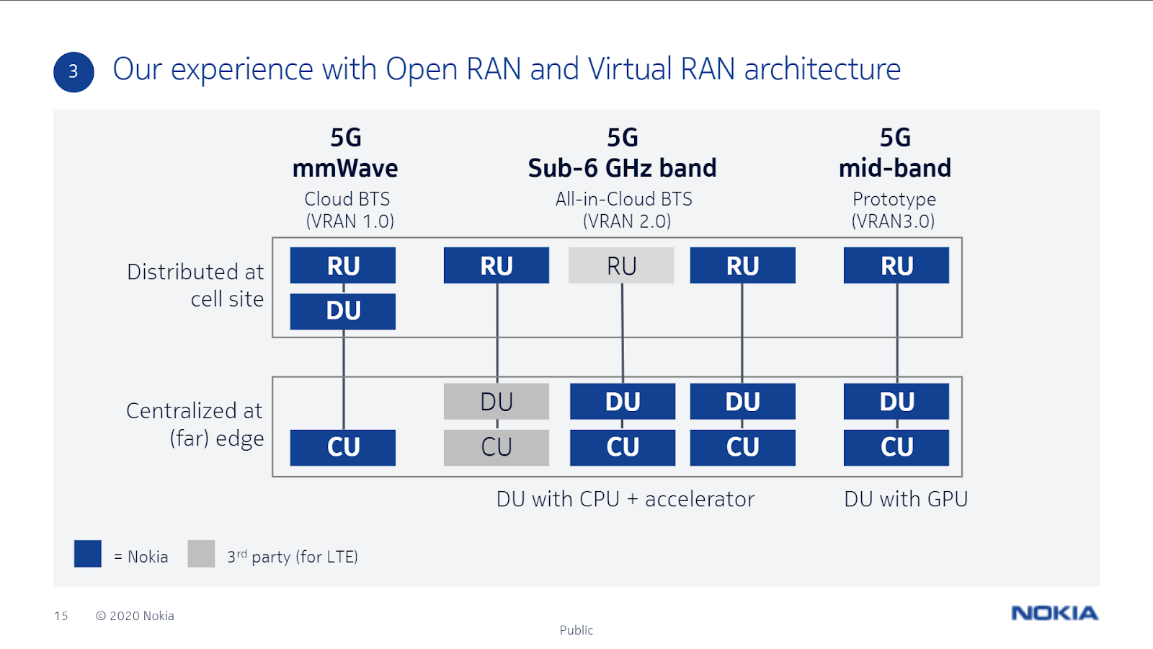
Open RAN: RU, DU, CU: Why? What? When? How?
Notes:
https://www.sdnlab.com/24553.html

Slide 5
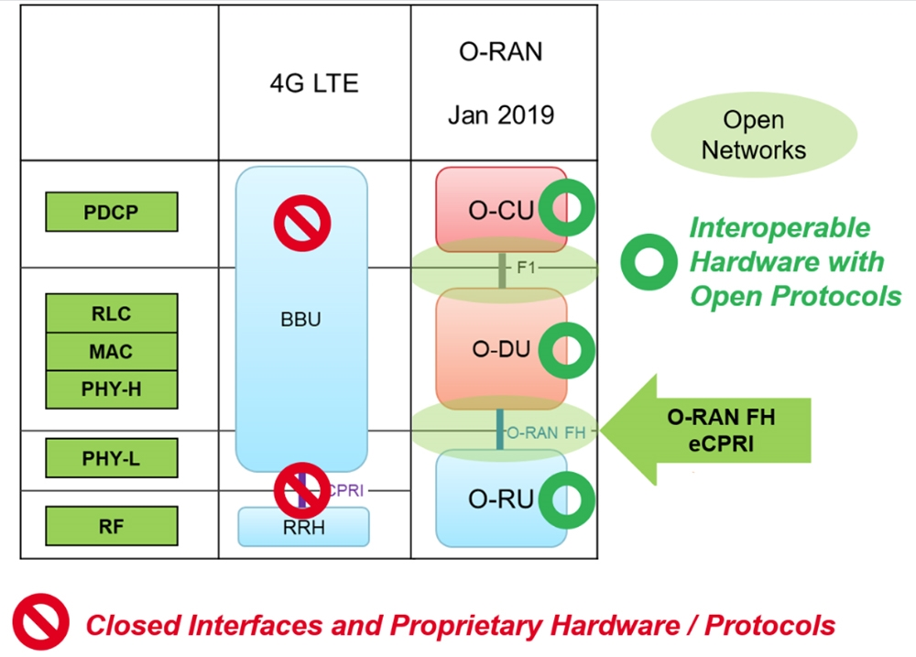
Notes:
https://www.2cm.com.tw/2cm/zh-tw/market/A9021CF00A0C4A7A9424ECBDF997E7C6

